Slide 1
Multipurpose Advanced Agricultural Framework
Interim Review
Group 5
Dr. Vivek Lukose

Slide 2
Contents
Introduction
Objective
Literature Review
Methodology
Budget
Conclusion
References

Slide 3
Introduction
A strong focus in the development of robotic and automated field operations systems has intensified during the past years[1].
Robotics for agricultural purposes can aid the execution of repetitive and heavy manual operations improving, the conditions of agricultural workers.
Robotic systems can enhance precision agricultural tasks like harvesting processes,irrigation,soil leveler,seed sowing etc.

Slide 4
The main issue in agricultural rover design is the ability of these robots to operate in unstructured agricultural environments.
They must ensure human safety and the preservation of the environment.
This work is focused on mobile robot framework which is developed for agricultural applications.

Slide 5
Objective
The aim of this project is to develop a multipurpose framework, which can maneuver through the spaces between the crops in a row wise planted field.
The proposed framework has the ability to make 90 degree turns.

Slide 6
Literature Review
Suspension
S.NO | TYPES | AUTHOR | YEAR | CHARACTERISTICS
1 | Linear Suspension | Califan F. , Cosenza[2] | 2022 | Consumes more energy; needs bigger battery
2 | Rocker - Bogie | Califan F. , Cosenza[2] | 2022 | Consumes less energy; Needs smaller battery; Can not be used for high speeds
 |  | Tomaszuk, Lukowska [3] | 2019 | Design is simple, durable and ensure low damage rate

Slide 7
Framework
S.NO | TYPES | AUTHOR | YEAR | CHARACTERISTICS
1 | SS and MS steel | Nazib Ahmad[6] | 2018 | ensures Safety and stability of the structure and also helps to absorb unbalanced pressure
2 | aluminum | João P. L. Ribeiro [8] | 2022 | very strong and lightweight also it allows easy attachment of different parts
3 | aluminum | T. Hojnik[9] | 2020 | optimise the strength-to-weight ratio

Slide 8
Motor
S.NO | TYPES | AUTHOR | YEAR | CHARACTERISTICS
1 | 12V brushless DC motor | Califano [2] | 2022 | Helps in running the wheels that drive the heavy loaded rovers

Slide 9
Wheels
S.NO | TYPES | AUTHOR | YEAR | CHARACTERISTICS
1 | Conventional wheels | Ahmad Najmuddin Ibrahim[5] | 2019 | There is a high tendency for the wheels to experience a high slip and dig into the soft surface.
2 | Grouser Wheel | Junlong Guo[4] | 2021 | Grousers attached to wheel surface improves the mobility when moving through loose soil.
 |  | Ahmad Najmuddin Ibrahim[5] | 2019 | Maintaining a constant angle using the adjustable grouser we can reduce the amount of sand being excavated from under the wheel towards the back of the wheel thus reducing slippage

Slide 10
Simulation Software
S.NO | TYPES | AUTHOR | YEAR | CHARACTERISTICS
1 | Gazebo Software | Marius Marian Deborah S. Katz[11] | 2020 | The user will be able to see and understand the simulation and movement of a mobile robot on a predefined map, before the robot to be used in a real world.
2 | CoppeliaSim Simulator | Gorkem Anil Al[7] | 2021 | Powerful, realistic and exact volumetric proximity sensor simulation.

Slide 11
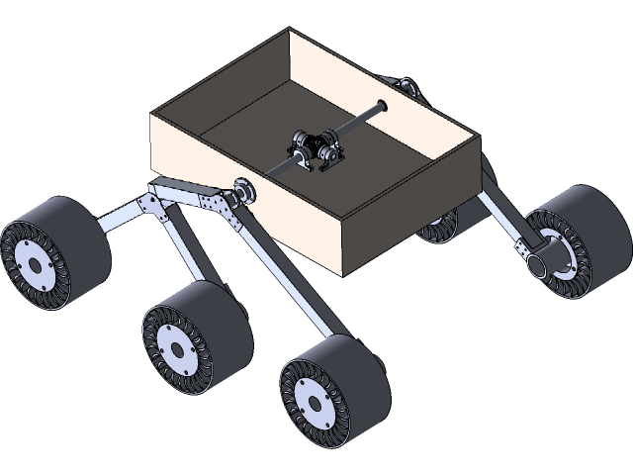
Methodology
Suspension
Bogie suspensions have various advantages including an improved adhesion of tires on the road.
The suspensions enable the framework to have low center of gravity which increases stability [2][3].

Slide 12
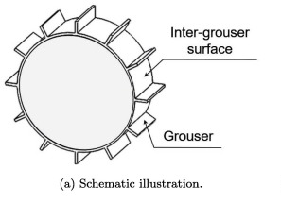
Wheels
Grousers can be attached to wheel surface to improve the mobility when shearing a large volume of soil.[4]
Grousers are traction-improving patterns that have been implemented on the surface of the wheels.

Slide 13
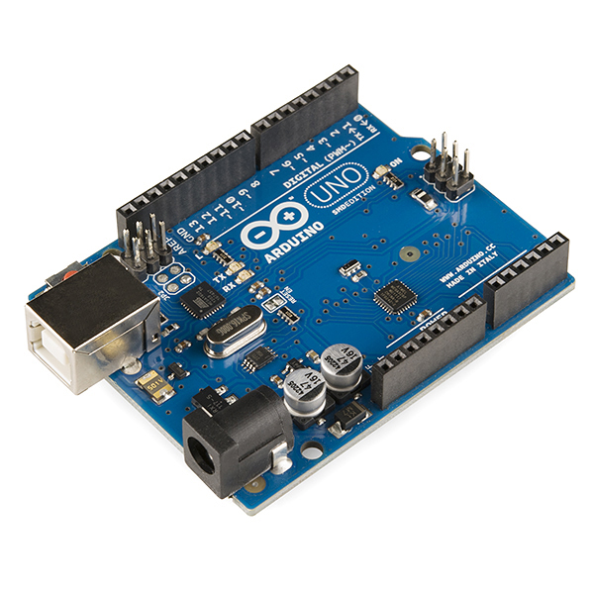
Micro Controller
Arduino UNO is a microcontroller board based on the ATmega328P. It has 14 digital input/output pins, 6 analog inputs, a USB connection, a power jack and a reset button.
Arduino Uno has tons of libraries with an active user community to help debug problems with code.

Slide 14
Framework
Aluminum profile system is now so commonly used is that they offer a fast assembly, easy reconfiguration, and unlimited flexibility.
Aluminium is more likely to deform or bend under any weight, force or heat hence hence it allows easy deformation and attachment of frames in the making of rover structure

Slide 15
Motor
Brushless motors are typically smoother and more efficient than brushed motors,have higher torque-to-power ratio and offer higher speeds.
Resistant to harsh elements and shocks, the compact and durable design of brushless DC motors makes them ideal for powering the wheels of these rovers

Slide 16
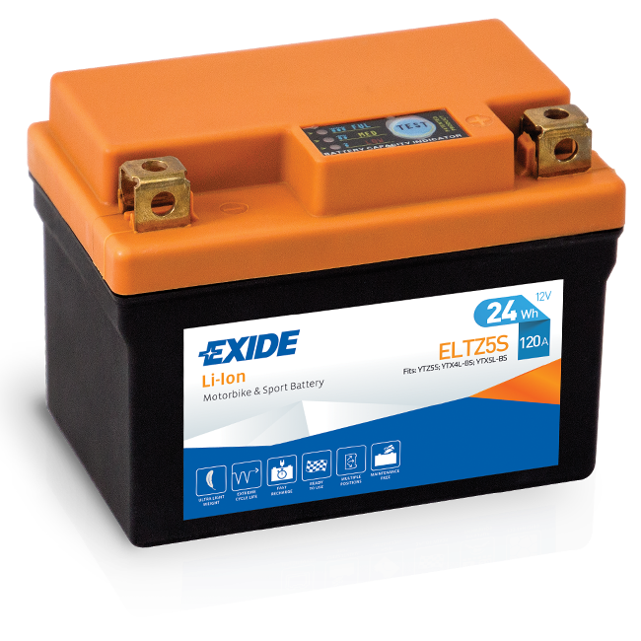
Power Source
Li-Ion does provide significant weight reduction when compared to lead acid batteries also provides constant power.
Lithium-Polymer Battery does not lose its charging capacity as fast as a Li-Ion battery.

Slide 17
Block Diagram
DC Motor (turning mechanism)
RC Signal
Arduino UNO
DC Motor (linear movement)
Battery(Li-ion, Li-Po, Lead-Acid)

Slide 18
Budget (Estimation)
S.NO | Name | price
1 | Material : aluminium | 210 - 300 rs per kg
2 | Microcontroller : arduino uno | 951 - 1089
3 | All terrain wheels
4 | Ak2 ultrasonic sensor / LIDAR | 2500 rs
5 | Brushless DC motor | 1000 - 2000
6 | Suspension | 1800 - 2100 rs
7 | Battery

Slide 19
Conclusion
The various parts of the framework have been finalised with the exception of a few, which with further testing will be finalised.
The Multipurpose Agricultural Advanced Framework that has been discussed here has the potential to be employed in the fields.

Slide 20
References
Liu, Y.; Ma, X.; Shu, L.; Hancke, G.P.; Abu-Mahfouz, A.M. From Industry 4.0 to Agriculture 4.0: Current Status, Enabling Technologies, and Research Challenges. IEEE Trans. Ind. Inform. 2021, 17, 4322–4334. [Google Scholar] [CrossRef]
Califano, F.; Cosenza, C.; Niola, V.; Savino, S. Multibody Model for the Design of a Rover for Agricultural Applications: A Preliminary Study. Machines 2022, 10, 235.
Tomaszuk, P., Lukowska, A., Recko, M., Dzierzek, K., & Straszynski, P. (2019). Active wheel speed control to avoid lifting the swingarms in rocker-bogie suspension. 2019 International Young Engineers Forum (YEF-ECE). doi:10.1109/yef-ece.2019.8740821
Guo, J., Li, W., Ding, L., Gao, H., Guo, T., Huang, B., & Deng, Z. (2021). Linear Expressions of Drawbar Pull and Driving Torque for Grouser-Wheeled Planetary Rovers Without Terrain Mechanical Parameters. IEEE Robotics and Automation Letters, 6(4), 8197–8204
Ibrahim, A. N., Sabarudin, S. S., & Fukuoka, Y. (2019). Effects of Wheel Grouser Angle of Attack on Simulated Robot Wheel Performance on Soft Sand with High Slip Condition. 2019 IEEE 4th International Conference on Advanced Robotics and Mechatronics (ICARM)
Ibna Rouf Uday, T., Ahmad, N., Ghosh, A., Jahin, J., Rahman, M. M., Iqbal, M. I., … Tithi, F. S. (2018). Design and Implementation of the Next Generation Mars Rover. 2018
Al, Estrela, P., & Martinez-Hernandez, U. (2020). Towards an intuitive human-robot interaction based on hand gesture recognition and proximity sensors. 2020 IEEE International Conference on Multisensor Fusion and Integration for Intelligent Systems (MFI).
João P. L. Ribeiro 1 , Pedro D. Gaspar 1,2 , Vasco N. G. J. Soares 3,4 and João M. L. P. Caldeira 3,4 Computational Simulation of an Agricultural Robotic Rover for Weed Control (2022)
T. Hojnik, R. A. Dungavell, P. D. Flick and J. M. Roberts, "Wheeled Rovers With Posable Hubs for Terrestrial and Extraterrestrial Exploration," in IEEE Access, vol. 8, pp. 154318-154328, 2020, doi: 10.1109/ACCESS.2020.3018429.

Slide 21
Marian, M., Stinga, F., Georgescu, M.-T., Roibu, H., Popescu, D., & Manta, F. (2020). A ROS-based Control Application for a Robotic Platform Using the Gazebo 3D Simulator. 2020 21th International Carpathian Control Conference (ICCC)

Slide 22
THANKS!
Any questions?

